Slide 1
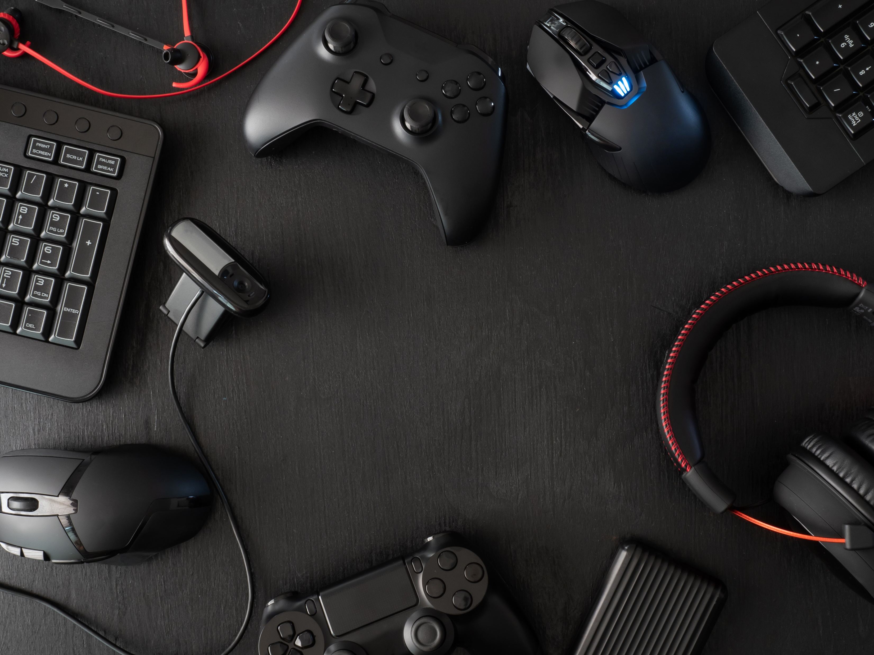

Cody’s New Sidescroller
Developer: Cody Brookshire
This is a fun video game with a classic feel, but with a new twist that will keep you coming back to play more! The speed and feel of the game are addicting!

